Slide 1
Attendance policy
Do not mark yourself present unless you can stay until I reconcile the attendance claims with the count of students actually present.
If you miss a class, please make it up by looking at the recorded video, at least up to the time that the in-class exercises begin, and email me when you have done so.
I will enforce the < 10% missed classes attendance policy by looking at the attendance from the beginning of class up to two weeks before the date when I look, and if I find three missed classes, not made up and noted in an email, you will not be allowed to take the final exam.
Attendance in person is strongly encouraged, to be able to ask questions, and show me in-class exercises or get help with them.

Slide 2
Animation
Repeatedly call a function to redraw in image
For each redraw
Clear the screen
Draw the image using the current time parameter

Slide 3
// RotatingTriangle.js (c) 2012 matsuda
// Vertex shader program
var VSHADER_SOURCE =
'attribute vec4 a_Position;\n' +
'uniform mat4 u_ModelMatrix;\n' +
'void main() {\n' +
' gl_Position = u_ModelMatrix * a_Position;\n' +
'}\n';
// Fragment shader program
var FSHADER_SOURCE =
'void main() {\n' +
' gl_FragColor = vec4(1.0, 0.0, 0.0, 1.0);\n' +
'}\n';

Slide 4
// Rotation angle (degrees/second)
var ANGLE_STEP = 45.0;
function main() {
...
// Specify the color for clearing <canvas>
gl.clearColor(0.0, 0.0, 0.0, 1.0);
// Get storage location of u_ModelMatrix
var u_ModelMatrix = gl.getUniformLocation(gl.program, 'u_ModelMatrix');
if (!u_ModelMatrix) {
console.log('Failed to get the storage location of u_ModelMatrix');
return;
}
var modelMatrix = new Matrix4();

Slide 5
// Start drawing
var tick = function() { // anonymous function
var currentAngle = animate(); // Update the rotation angle
draw(gl, n, currentAngle, modelMatrix, u_ModelMatrix);
requestAnimationFrame(tick, canvas); // Make the browser calls tick
};
tick();
} // end of main()
var g_last = Date.now(); // time in milliseconds at start of program
function animate() {
// Calculate the elapsed time
var now = Date.now(); // time in milliseconds at current iteration
var elapsed = now - g_last; // elapsed time in milliseconds since start
// Compute the current rotation angle, proportional to elapsed time
var currentAngle = ANGLE_STEP * (elapsed / 1000.0);
return currentAngle %= 360;
}

Slide 6
function draw(gl, n, currentAngle, modelMatrix, u_ModelMatrix) {
// Set the rotation matrix
modelMatrix.setRotate(currentAngle, 0, 0, 1);
// Pass the rotation matrix to the vertex shader
gl.uniformMatrix4fv(u_ModelMatrix, false, modelMatrix.elements);
// Clear <canvas>
gl.clear(gl.COLOR_BUFFER_BIT);
// Draw the triangle
gl.drawArrays(gl.TRIANGLES, 0, n);
}

Slide 7
Interpolating color in conceptual GPU data flow diagram
per-vertex
data
Vertex
Shader
program
Scan conversion
and variable
data interpolation
transformed
per-vertex data
fragments with
per-fragment data
texel address
Fragment
Shader
program
Texture
Memory
texel
data
Bilinear
texture
interpolation
data from
4 texels
pixel address
Active
Frame
Buffer
RGBA color
RGBA
Compositing
and
Depth Test
depth
depth
Depth
Buffer

Slide 8
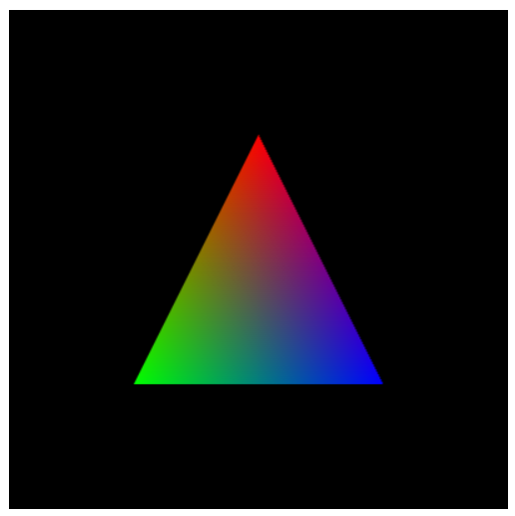
Interpolating color: examples/ch05/ColoredTriangle.js

Slide 9
Interpolating color across a triangle
Specify a possibly different color for each vertex of a triangle to the vertex shader using an attribute a_color.
In the vertex shader, copy that attribute color a_color to a “varying” color v_color.
The varying color is interpolated as the triangle is scan converted.
The fragment program uses the same varying parameter name v_color to get the interpolated color and assign it to v_FragColor.

Slide 10
// MultiAttributeColor.js (c) 2012 Matsuda, modified by Nelson Max
// Vertex shader program
var VSHADER_SOURCE =
'attribute vec4 a_Position;\n' +
'attribute vec4 a_Color;\n' +
'varying vec4 v_Color;\n' + // varying variable
'void main() {\n' +
' gl_Position = a_Position;\n' +
' v_Color = a_Color;\n' + // Pass the data to the fragment shader
'}\n';
// Fragment shader program
var FSHADER_SOURCE =
'precision mediump float;\n' + // Precision qualifier (See Chapter 6)
'varying vec4 v_Color;\n' + // Interpolated data from vertex shader
'void main() {\n' +
' gl_FragColor = v_Color;\n' +
'}\n';

Slide 11
// original MultiAttributeColor.js (c) 2012 matsuda
// Vertex shader program
var VSHADER_SOURCE =
'attribute vec4 a_Position;\n' +
'attribute vec4 a_Color;\n' +
'varying vec4 v_Color;\n' + // varying variable
'void main() {\n' +
' gl_Position = a_Position;\n' +
' gl_PointSize = 10.0;\n’ + // not necessary for drawing a triangle
' v_Color = a_Color;\n' + // Pass the data to the fragment shader
'}\n';
// Fragment shader program
var FSHADER_SOURCE =
'#ifdef GL_ES\n’ + // this does not work in modern browsers
'precision mediump float;\n' + // Precision qualifier (See Chapter 6)
'#endif GL_ES\n’ + // this does not work in modern browsers
'varying vec4 v_Color;\n' + // Receive the data from the vertex shader
'void main() {\n' +
' gl_FragColor = v_Color;\n' +
'}\n';

Slide 12
function initVertexBuffers(gl) {
var verticesColors = new Float32Array([
// Vertex coordinates and color
0.0, 0.5, 1.0, 0.0, 0.0,
-0.5, -0.5, 0.0, 1.0, 0.0,
0.5, -0.5, 0.0, 0.0, 1.0,
]);
var n = 3; // The number of vertices // Create a buffer object
var vertexColorBuffer = gl.createBuffer();
if (!vertexColorBuffer) {
console.log('Failed to create the buffer object');
return false;
}
// Write the vertex coordinates and colors to the buffer object
gl.bindBuffer(gl.ARRAY_BUFFER, vertexColorBuffer);
gl.bufferData(gl.ARRAY_BUFFER, verticesColors, gl.STATIC_DRAW);

Slide 13
var FSIZE = verticesColors.BYTES_PER_ELEMENT;
//Get the storage location of a_Position, assign and enable buffer
var a_Position = gl.getAttribLocation(gl.program, 'a_Position');
gl.vertexAttribPointer(a_Position, 2, gl.FLOAT, false, FSIZE*5, 0);
gl.enableVertexAttribArray(a_Position); // Enable the assignment of buffer object
// Get the storage location of a_Position, assign buffer and enable
var a_Color = gl.getAttribLocation(gl.program, 'a_Color');
}
gl.vertexAttribPointer(a_Color, 3, gl.FLOAT, false, FSIZE*5, FSIZE*2);
gl.enableVertexAttribArray(a_Color); // Enable the assignment of buffer object
return n;
}

Slide 14
The result of examples/ch05/ColoredTriangle.js

Slide 15
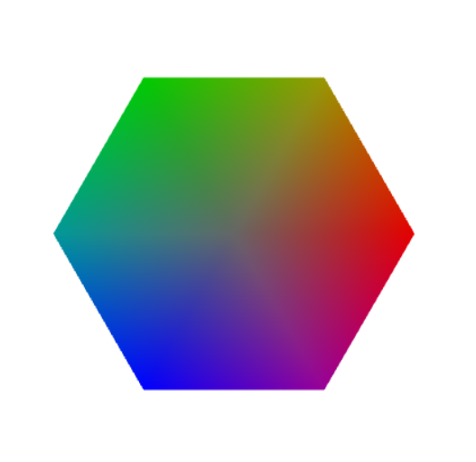
Class Exercises a) Make a color hexagon
Draw a hexagon as a fan of six triangles. The center vertex of the fan is a gray color (.4, .4, .4). The outer 6 vertex colors are shown below. The colors are interpolated linearly across each triangle of the fan.
green: (0., .8, 0.)
yellow: (.6, .6. 0.)
cyan: (0., .6, .6)
red: (.9, 0., 0.)
blue: (0., 0., 1.)
magenta: (.6, 0., .6)

Slide 16
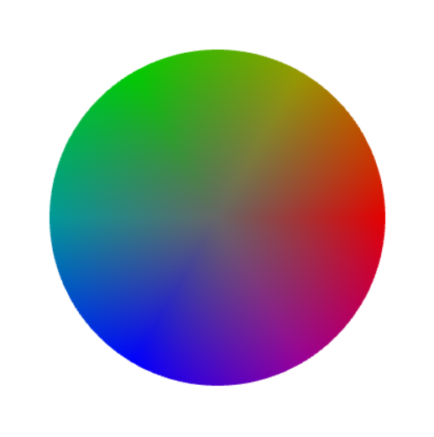
Class Exercises b) Make a color circle
Draw a circle as a fan of 360 triangles. The center vertex of the fan is a gray color (.4, .4, .4). The outer 360 vertex colors are interpolated between the hexagon vertex colors, linearly in arclength on the circle.
green: (0., .8, 0.)
yellow: (.6, .6. 0.)
cyan: (0., .6, .6)
red: (.9, 0., 0.)
blue: (0., 0., 1.)
magenta: (.6, 0., .6)

Slide 17
Class Exercises b) Make a color circle
Draw a circle as a fan of 360 triangles. The center vertex of the fan is a gray color (.6, .6, .6). The outer 360 vertex colors are interpolated between the hexagon vertex colors, linearly in arclength on the circle.
for (i = 0; i <= 360; ++i) {
r = 6*i/360; // varies from 0 to 6
k = Math.floor(r);
fac = r – k; // varies from 0 to 1
... }
Use 1 - fac and fac to interpolate between hexagon colors k and k+1.

Slide 18
Class Exercise: Draw a triangle-fan polygon with an outline using mouse clicks
Combine the three WebGL / JavaScript examples files ClickedPoints.js and ColoredPoints.js from ch02, and HelloQuadFan.js and HelloQuad_LINE_LOOP.js from ch03 to draw a polygon with a fill color, together with its outline in another color, over a background in a third color. Create a fixed size new Float32Array(100) with room for 50 vertex pairs from clicked points and pass it as the vertex attribute buffer.

Slide 19
Class exercise: rotating a triangle around a vertex.
Write a JavaScript WebGL program to rotate the triangle with vertices at A = (-.5. -.5), B = (.5, -.5) and C = (0, .5) by 30 degrees counterclockwise around its top vertex C.
Do this using the Matrix4 functions in cuon-matrix.js, by modifying the code in examples/ch04/RotatedTranslatedTriangle.js to include the three transformations in Steps 1, Step 2, and Step 3 above, instead of just two. Be careful of the distinction between modelMatrix.setTranslate(), which sets modelMatrix to a translation, and modelMatrix.translate, which multiplies an existing modelMatrix on the right by a translation. Also be careful to multiply the matrices in the correct order, by calling these function in the correct order.

Slide 20

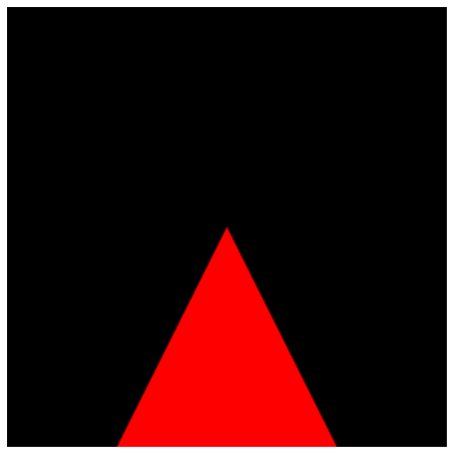


Appearance after each of the 3 steps
Initial After step1 After step 2 After step 3

